Slide 1
Revelation 8

Slide 2
Revelation 8:3,5: Observations
³ And another angel came and stood at the altar, having a golden censer; and there was given unto him much incense, that he should offer it with the prayers of all saints upon the golden altar which was before the throne.
⁵ And the angel took the censer, and filled it with fire of the altar, and cast it into the earth: and there were voices, and thunderings, and lightnings, and an earthquake.
Altar
Part of worship to God
Part of God’s wrath and judgment
Notes:
Wake-up call after 30 minute intermission
This is not the last time we see God’s judgment displayed through the altar
Something interesting will happen with the altar in chapter 9 that takes us back to the O.T. law

Slide 3
Revelation 8:10-11
¹⁰ And the third angel sounded, and there fell a great star from heaven, burning as it were a lamp, and it fell upon the third part of the rivers, and upon the fountains of waters;
¹¹ And the name of the star is called Wormwood: and the third part of the waters became wormwood; and many men died of the waters, because they were made bitter.

Slide 4
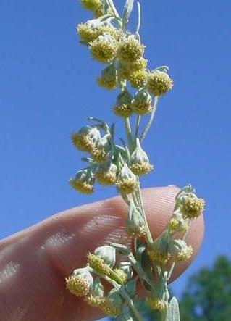
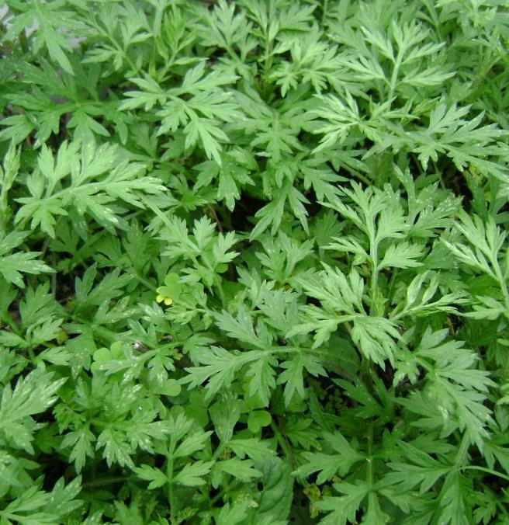
Revelation 8:11: Wormwood
Notes:
Wormwood: Appears 25 times in the Bible in 10 verses. No stranger to the Bible.
Wormwood Toxicity
Poisonous and very bitter plant.
Leaves cannot be eaten, but has medicinal qualities
If leaves rubbed on the skin, could result in painful skin burn.
Eating the plant will cause a disruption to the central nervous system and could cause death when consumed in large enough quantities.
Contains some medicinal qualities.
=================================================
Question: Does “wormwood” represent the Word of God?
Answer: In later chapter, “bitter” is a description of response to the Word of God, but not here.
God’s word does not cause physical death.
=================================================
Question: Does the star “wormwood” represent Satan?
Luke 10:18: “And He [Jesus] said to them, “I saw Satan as lightning fall from heaven.”
Answer: No, Satan is represented in another way in Revelation 9.
=================================================
Take “Wormwood” at face value and not try to assign an identity to it.

Slide 5
Revelation 8:7-12
“Trumpet Angels” 1 – 4
#1 - Hail & fire mixed with blood
Trees and grass burned
#2 - Burning mountain cast into sea
1/3 sea turned to blood
#3 - Great star fell on rivers, fountains
Star named “Wormwood”
Water became bitter; death
#4 - Sun, moon, stars darkened
1/3 light turned to darkness
Notes:
“Trumpet Angels” 1 – 4
#1 - Hail & fire mixed with blood
Trees and grass burned
#2 - Burning mountain cast into sea
1/3 sea turned to blood
#3 - Great star fell on rivers, fountains
Star named “Wormwood”
Water became bitter; death
#4 - Sun, moon, stars darkened
1/3 light turned to darkness
There is something that God is saying in chapter 8
See pattern?

Slide 6
Revelation 8:13
¹³ And I beheld, and heard an angel [eagle] flying through the midst of heaven, saying with a loud voice, Woe, woe, woe, to the inhabiters of the earth by reason of the other voices of the trumpet of the three angels, which are yet to sound!
“ἀετοῦ” (aetou) - eagle, not angel
Angel laments for people still alive on earth
More punishments are coming . . .
Notes:
In Alabama terms, “You ain’t seen nut’n, yet.”

Slide 7
Revelation 9

Slide 8
Revelation 9:1; 13
“Trumpet Angels” 5 - 7
#5 - Star fall from the heavens
Keys to bottomless pit
Free demons for battle
#6 - Armies gather to make war
1/3 men were killed
#7 - Kingdom proclaimed
Revelation 11
Notes:
God shows his dominance
Now, God is preparing for his final judgment of villain of Revelation

Slide 9
Revelation 8 , 9
“Trumpet Angels” 1 – 7
#1 - Trees and grass burned
#2 - Mountain cast into sea
#3 - Water became bitter; death
#4 - Sun, moon, stars darkened
#5 - Bottomless pit unlocked
#6 - Armies gather to make war
#7 - Kingdom proclaimed (Rev 11)
Vegetation
Land
Pattern?
Waters
Heavens
Evil gathers its forces
Army slaying evil
Kingdom
Notes:
God will not explicitly say what he does to punish. It is all symbolic.
God basically “moves heaven and earth” to bring about repentance.
Providence of God?
God gave villain room to repent with punishments (what those are, we do not know).
God even involves evil in the punishment and influence of trying to get evil to repent.
Then, God proclaims his kingdom, and prepares for final judgment.
#6: Could be literal battles discussed in chapter 17.
God’s dominance
Over earth and universe
Can change status to affect behavior of evil
Regardless of God’s efforts, Revelation 9:20-21 says villain repented not.
Does God allow struggles and battles into our lives to humble us? Bring about repentance?

Slide 10
Revelation 9: Observations
⁴ And it was commanded them that they should not hurt the grass of the earth, neither any green thing, neither any tree; but only those men which have not the seal of God in their foreheads.
God has dominion over:
Nature
Chapter 8; 9:4
Demons
Locust from bottomless pit
Book of Job (God limits Satan)
Punishment
Punishes some without impacting others
Evil - uses evil to punish evil
Satan gladly destroys his own
Notes:
Rev 9
Demonstrated throughout the Bible, including Revelation
Beings from bottomless pit are evil
God controls who and what they will harm or kill
Ultimately, God is in control

Slide 11
Revelation 9: Observations
¹³ And the sixth angel sounded, and I heard a voice from the four horns of the golden altar which is before God,
¹⁴ Saying to the sixth angel which had the trumpet, Loose the four angels which are bound in the great river Euphrates.
¹⁵ And the four angels were loosed, which were prepared for an hour, and a day, and a month, and a year, for to slay the third part of men.
Why even mention the 4 horns of the altar?

Slide 12
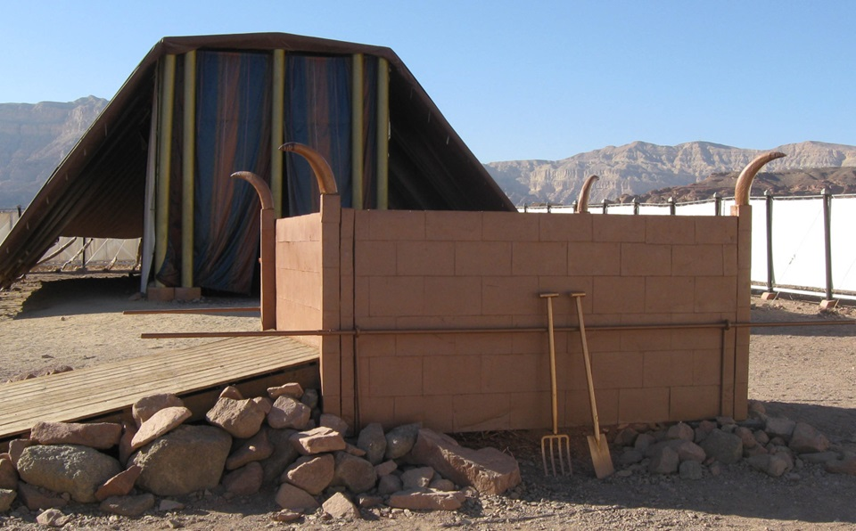
Notes:
Priest wiped blood from the sacrifice onto the horns of the altar.
What other purpose did the horns of the altar serve?
1 Kings 1 & 2
Adonijah
Joab
1 Kings 1:50
“And Adonijah feared because of Solomon, and arose, and went, and caught hold on the horns of the altar.”
Horns of altar provided refuge for fugitives.
Significance of altar horns’ voice?
Even the altar horns will not save you from the judgment, punishment, and wrath of God
When opportunity to repent is passed, there is no where to run to and no where to hide.
In Chapter 6, evil even wanted the mountains to fall upon them to hide them from the wrath of God . . . to no avail.

Slide 13
Revelation 9: Observations
Priest wiped blood from sacrifice onto altar horns
What other purpose did the horns of the altar serve?
1 Kings 1:49 - Adonijah
1 Kings 2:28 - Joab
Horns of altar provided refuge to spare life
Significance of altar horns’ voice?
Even altar horns will not save you from God’s wrath
Time to repent is passed, no where to run to, no where to hide
Chapter 6 - evil wants mountains to fall on them, hide from wrath
Notes:
Priest wiped blood from the sacrifice onto the horns of the altar.
1 Kings 1:49-50
49 - At this, all the guests of Adonijah arose in terror and scattered.
50 - But Adonijah, in fear of Solomon, got up and went to take hold of the horns of the altar.
1 Kings 2:28
28 - When the news reached Joab, who had conspired with Adonijah but not with Absalom, he fled to the tent of the LORD and took hold of the horns of the altar.
Even the altar horns will not save you from the judgment, punishment, and wrath of God
When opportunity to repent is passed, there is no where to run to and no where to hide.
In Chapter 6, evil even wanted the mountains to fall upon them to hide them from the wrath of God . . . to no avail.

Slide 14
Revelation 9: Revelation Characteristic
Revelation 9:17 (NKJV)
¹⁷ And thus I saw the horses in the vision: those who sat on them had breastplates of fiery red, hyacinth blue, and sulfur yellow;
Revelation is
Colorful

Slide 15
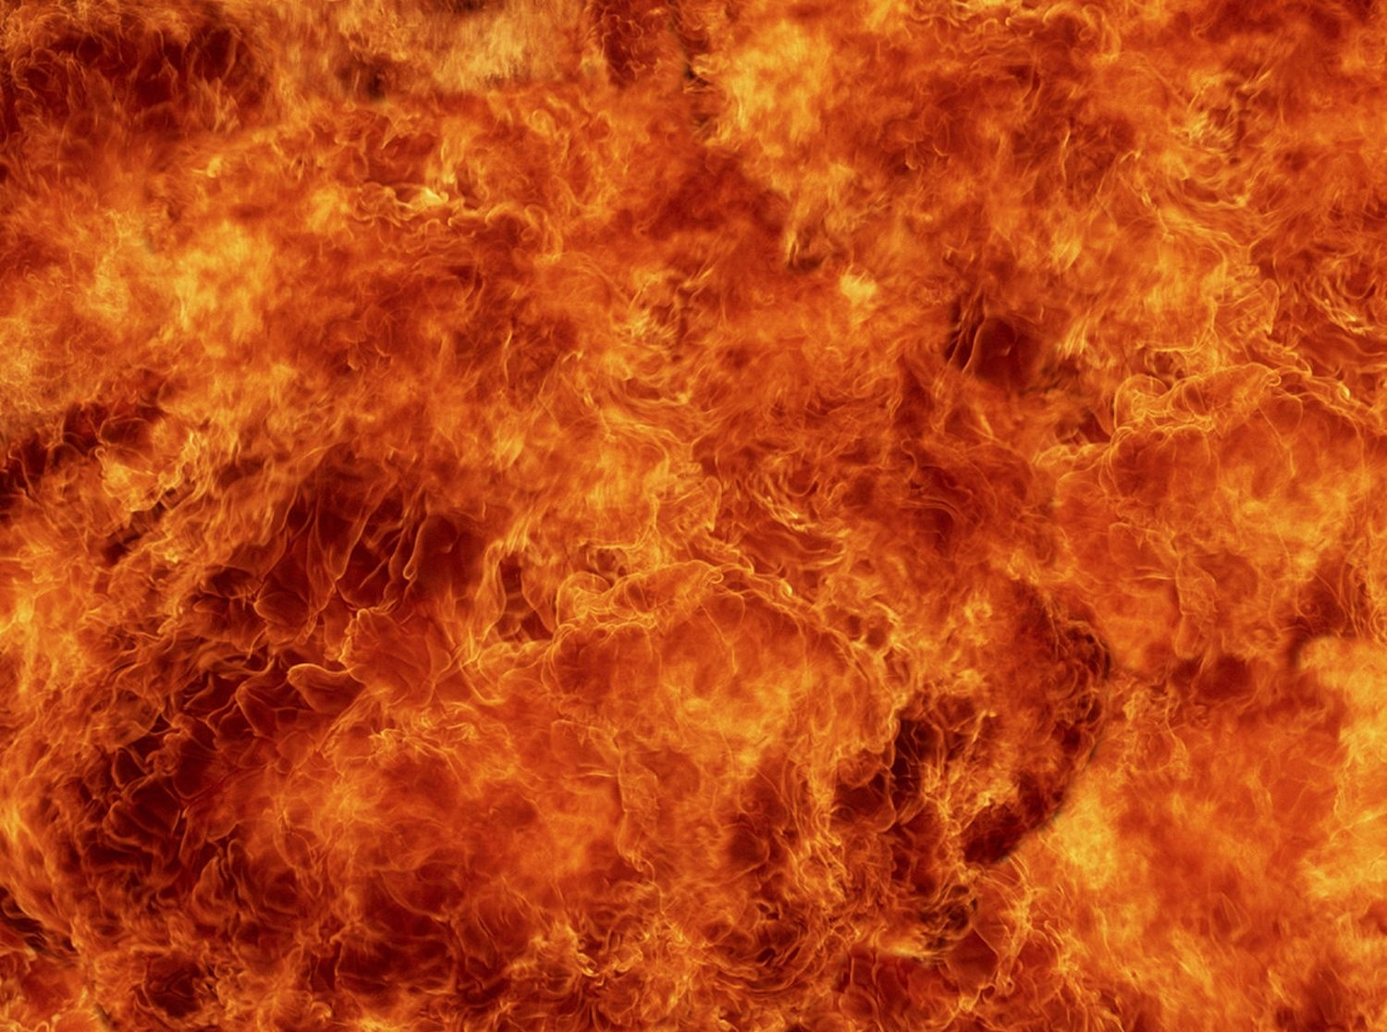
Fiery Red

Slide 16
Hyacinth Blue

Slide 17
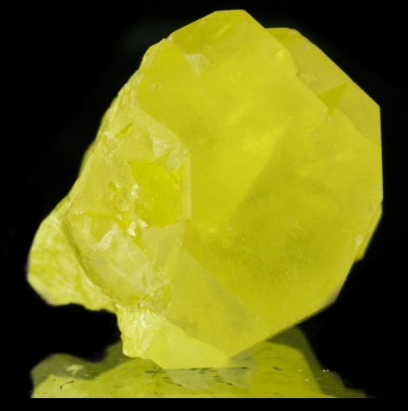
Sulfur Yellow

Slide 18
Revelation: Overview
How To Convince A Premillennialist?
Convince them from Revelation
Pre-M Revelation interpretation always takes priority
Tribulation, 4 Horsemen, “Anti-Christ”, 1000 Year Reign
Go on offense – question why they believe Pre-M
How does Pre-M help 7 churches of Asia in 1st century?
Revelation vs. what their “St.’s” wrote in N.T.
“St.” Paul, Peter, John, . . . disagree with Pre-M’s Rev. beliefs
Use Revelation, history, logic, evidence, proof
Notes:
Convince from Revelation
Tribulation vs Pre-M (God scrub you clean?)
4 Horsemen vs Pre-M (escort your soul?)
“Anti-Christ” vs Pre-M (prophecy?)
Armageddon vs Pre-M (end of world?)
1000 Year Reign vs Pre-M (Kingdom established already?)
Go on offense
Kingdom = Church, not 1000 Year Reign
Kingdom not of this world
Doctrine of “Blood of the Lamb”

Slide 19
Revelation 9: Questions
Questions
What is the “bottomless pit”?
Who is the “star” (Ch. 9) that fell from the sky and given keys to bottomless pit?
Who is “Abaddon” and “Apollyon”?
Why does all of this even matter?

Slide 20
Revelation 9: Questions
Questions
What is the “bottomless pit”?
Who is the “star” (Ch. 9) that fell from the sky and given keys to bottomless pit?
Who is “Abaddon” and “Apollyon”?
Why does all of this even matter?

Slide 21
Revelation 9:2-3
² And he opened the bottomless pit; and there arose a smoke out of the pit, as the smoke of a great furnace; and the sun and the air were darkened by reason of the smoke of the pit.
³ And there came out of the smoke locusts upon the earth: and unto them was given power, as the scorpions of the earth have power.
5 “abyss” characteristics
Smoke like from a great furnace
Filled with evil beings
Luke 8:30; Revelation 11
Revelation 20 – Abyss & Hell listed separately
Later, abyss tossed into Lake of Fire
Consistent with “Torment” (Rich Man and Lazarus)
Notes:
What is the abyss?
5 characteristics
Luke 8:30-31:
Jesus asked him, saying, “What is your name?” And he said, “Legion,” because many demons had entered him. And they begged Him that He would not command them to go out into the abyss.
Rev 11:
Beast ascends from BP to make war with prophets
Rich Man and Lazarus:
Abyss consistent with “Torment” in story of Rich Man and Lazarus
“Torment gives the occupants the sensation of continuously falling.” ???

Slide 22
Revelation 9: Questions
Questions
What is the “bottomless pit”?
Who is the “star” (Ch. 9) that fell from the sky and given keys to bottomless pit?
Who is “Abaddon” and “Apollyon”?
Why does all of this even matter?

Slide 23
Revelation 9:1
¹ And the fifth angel sounded, and I saw a star fall from heaven [Gr. “sky”] unto the earth: and to him was given the key of the bottomless pit [Gr. “abyss”].
Luke 10:18
4 Characteristics
Falling star from the heaven [Gr. “sky”?]
Given keys to abyss
Not identified as Satan
Satan referenced differently later in chapter 9
King of bottomless pit
Symbolism - No evidence “star” is Satan
Notes:
Luke 10:18 – “And He [Jesus] said unto them, I beheld Satan as lightning fall from heaven.”
Nothing explicitly identifying the “star” as being Satan, yet
Later, Satan called the “king and angel of the bottomless pit”.
Satan? High ranking demon? Symbolic?
God uses evil to accomplish his objectives

Slide 24
Revelation 9: Questions
Questions
What is the “bottomless pit”?
Who is the “star” (Ch. 9) that fell from the sky and given keys to bottomless pit?
Who is “Abaddon” and “Apollyon”?
Why does all of this even matter?

Slide 25
Revelation 9:11
¹¹ And they had a king over them, which is the angel [Gr. messenger] of the bottomless pit, whose name in the Hebrew tongue is Abaddon, but in the Greek tongue has his name Apollyon.
אֲבַדּוֹן - “Abaddon” (Hebrew) - 1x in N.T.
“The Destroyer”
“The minister of death”
“The angel of destruction”
Ἀπολλύων - “Apollyon” (Greek) - 1x in N.T.
“The destroying one”
King over:
Bottomless pit
Chief demon of “locust” army
Satan?
Notes:
Describes Satan

Slide 26
Revelation 9: Questions
Questions
What is the “bottomless pit”?
Who is the “star” (Ch. 9) that fell from the sky and given keys to bottomless pit?
Who is “Abaddon” and “Apollyon”?
Why does all of this even matter?

Slide 27
Revelation 9
Why study
Revelation?
Chs. 8 & 9?
Develop reasonable response from Revelation
Alternative to Pre-M
Based on context of Revelation, logic, evidence, proof
Pre-M assign their own literal interpretation
Characters, objects, events
Prove their own agenda
5 examples . . .
“adding to / taking away from words of this prophecy
Notes:
Adding to / taking from words of this prophecy
Lose their souls as a result

Slide 28
Revelation
Characteristic
Revelation
Characteristic
Revelation
Characteristic
“Disasters ‘R’ Us”
“Disasters ‘R’ Us”
“Disasters ‘R’ Us”
Notes:
Chapter 9: Premillennialistic Interpretations
5 real-life examples of exploited disasters
It means Pre-M need disasters to occur
They get excited when one does occur
With every disaster comes a claim that
Revelation predicted it
We are in the “Latter Days” or “Last Days”
1st Hebrews discusses “Last Days”, but isn’t the end of the world
Pre-M use to mean “end of world is at hand”
End of time is near
“Never let a good disaster go to waste.”

Slide 29
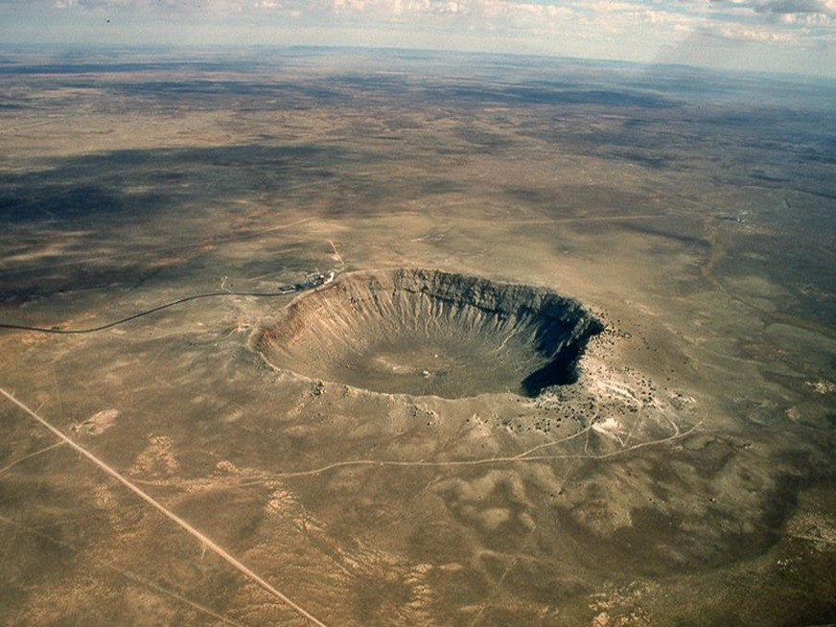
1. Barringer Crater, Arizona
“An Asteroid, A Comet, And The Coming Apocalypse”
by Richie Cooley
“Bible prophecy details a coming collision with heavenly bodies. This booklet details the startling accuracy of such forecasts.”
Notes:
“An Asteroid, A Comet, And The Coming Apocalypse” By Richie Cooley
About this book: “Bible prophecy details a coming collision with heavenly bodies. This booklet details the startling accuracy of such forecasts.”
According to Pre-M, “Wormwood” is an asteroid.

Slide 30
E. L. Martin: Worldwide Church of God
E. L. Martin’s Doomsday Prediction ¹
“It may come as a surprise to some people but the Holy Scriptures describe a time associated with the Second Advent of Christ that any modern day scientist would attest is a classic description of an asteroid or comet of a moderate size (say a mile or so in diameter) hitting the earth. After mentioning that the mercantile system on earth that provides wealth and prosperity is to be destroyed (read all of Isaiah 23 along with the future prophecies in the Book of Revelation about the same thing (Revelation 18:11-17), the prophet Isaiah continued his description of “Doomsday” by his prophecy recorded in all of Isaiah chapter 24. You should read that chapter and pay attention
¹ https:creationconcept.wordpress.com/2012/01/02/e-l-martins-doomsday-predictions/
Notes:
https://en.wikipedia.org/wiki/Ernest_L._Martin
Ernest L. Martin is a meteorologist, author, and minister in the Worldwide Church of God
In 1993, Ernest L. Martin of The Associates for Scriptural Knowledge published an article in which he described destruction of the world because of an impact with a comet, or an asteroid. He wrote:
Isaiah 24:1 Behold, the LORD maketh the earth empty, and maketh it waste, and turneth it upside down, and scattereth abroad the inhabitants thereof.

Slide 31
E. L. Martin: Worldwide Church of God
E. L. Martin’s Doomsday Prediction ¹
(continued)
to the complete and utter destruction of world civilization. The world will return to a barbaric state with only a few men left over the entirety of the earth, and the wide devastation will last for 70 years (Isaiah 23:17,18).”
¹ https:creationconcept.wordpress.com/2012/01/02/e-l-martins-doomsday-predictions/
Notes:
https://en.wikipedia.org/wiki/Ernest_L._Martin
Ernest L. Martin is a meteorologist, author, and minister in the Worldwide Church of God
In 1993, Ernest L. Martin of The Associates for Scriptural Knowledge published an article in which he described destruction of the world because of an impact with a comet, or an asteroid. He wrote:
Isaiah 24:1 Behold, the LORD maketh the earth empty, and maketh it waste, and turneth it upside down, and scattereth abroad the inhabitants thereof.

Slide 32
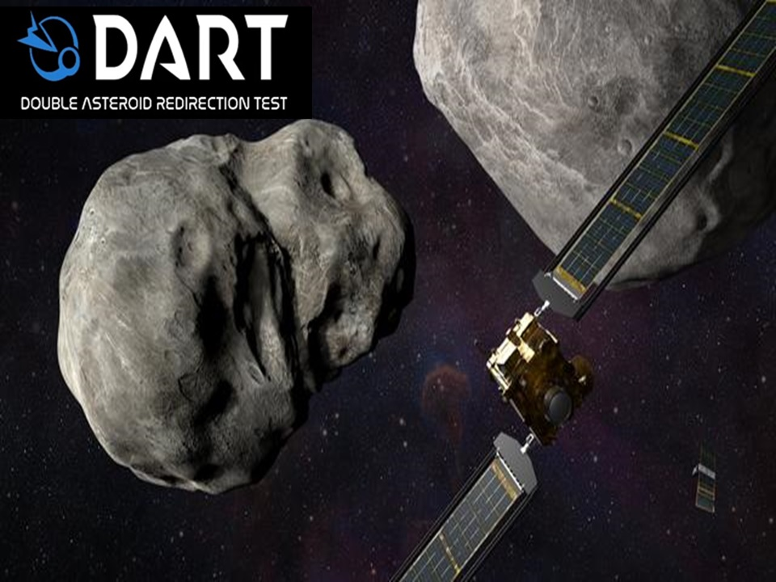
Notes:
Double Asteroid Redirection Test
Nasa is trying to prevent the Pre-M’s prophesy that an asteroid will bring Jesus’ return and the 1000 Year Reign

Slide 33
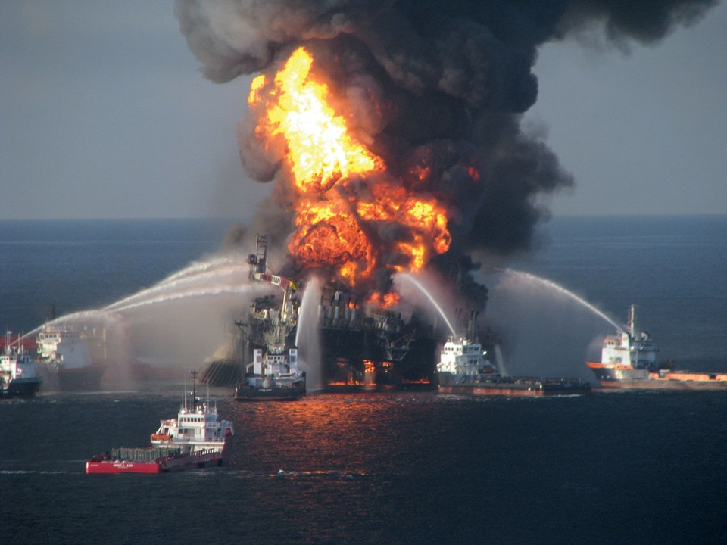
2. BP Oil Spill, 2010
https://www.newsweek.com/some-say-bps-oil-spill-heralds-apocalypse-73117
Notes:
https://www.newsweek.com/some-say-bps-oil-spill-heralds-apocalypse-73117
A growing conversation among Christian fundamentalists asks the question that may have been inevitable: is the oil spill in the gulf a sign of the coming apocalypse?
About 60 million white evangelicals live in America, and about one third of them believe that the world will end in their lifetime, according to the Pew Research Center for the People and the Press. Broadly speaking, these Christians subscribe to a theology called "premillennial dispensationalism." In this world view, they are warriors on the side of God: a cosmic battle—culminating in apocalypse, judgment, and, finally, the reign of Jesus in "a new heaven and a new earth"—will come soon. The most determined of these believers mine the Book of Revelation for signs that the end is near. A text of terrifying and mysterious prophesy, Revelation forecasts the apocalypse in coded language; Christians have spent lifetimes trying to break that code by correlating its verses to current events. (A New York minister named William Miller used Revelation and other sources to predict that the world would end on Oct. 22, 1844. He had previously predicted—wrongly, obviously—that the date would be March 21, 1843. The Millerites, once a powerful and fast-growing sect, quickly became extinct.)
Now blogs on the Christian fringe are abuzz with possibility that the oil spill is the realization of Revelation 8:8–11. "The second angel blew his trumpet, and something like a great mountain, burning with fire, was thrown into the sea. A third of the sea became blood, a third of the living creatures in the sea died, and a third of the ships were destroyed … A third of the waters became wormwood, and many died from the water, because it was made bitter." According to Revelation, in other words, something terrible happens to the world's water, a punishment to those of insufficient faith. The foul water, according to the New Oxford Annotated Bible, mirrors one of the plagues God called upon Egypt on behalf of his people Israel.
Though maybe it's Revelation 16:3: "The second angel poured his bowl into the sea, and it became like the blood of a corpse, and every living thing in the sea died."
Some interpreters are very sure: The oil spill matches biblical prophesy and is another predictor of the end. One commenter at Godlike Productions argues that the redness of the oil seen in pictures can be interpreted as blood. "The water is tinted red from the oil … it ACTUALLY looks like blood. coincidence???

Slide 34
2. BP Oil Spill, 2010
Some Say BP's Oil Spill Heralds the Apocalypse
June 3, 2010
A growing conversation among Christian fundamentalists asks the question that may have been inevitable: is the oil spill in the gulf a sign of the coming apocalypse?
About 60 million white evangelicals live in America, and about one third of them believe that the world will end in their lifetime, according to the Pew Research Center for the People and the Press. Broadly speaking, these Christians subscribe to a theology called "premillennial dispensationalism." In this world view, they are warriors on the side of God: a cosmic battle culminating in apocalypse,
https://www.newsweek.com/some-say-bps-oil-spill-heralds-apocalypse-73117

Slide 35
2. BP Oil Spill, 2010
judgment, and, finally, the reign of Jesus in "a new heaven and a new earth“ will come soon. The most determined of these believers mine the Book of Revelation for signs that the end is near. A text of terrifying and mysterious prophesy, Revelation forecasts the apocalypse in coded language; Christians have spent lifetimes trying to break that code by correlating its verses to current events. (A New York minister named William Miller used Revelation and other sources to predict that the world would end on Oct. 22, 1844. He had previously predicted—wrongly, obviously—that the date would be March 21, 1843. The Millerites, once a powerful and fast-growing sect, quickly became extinct.)
Now blogs on the Christian fringe are abuzz with possibility that the oil
https://www.newsweek.com/some-say-bps-oil-spill-heralds-apocalypse-73117

Slide 36
2. BP Oil Spill, 2010
spill is the realization of Revelation 8:8–11. "The second angel blew his trumpet, and something like a great mountain, burning with fire, was thrown into the sea. A third of the sea became blood, a third of the living creatures in the sea died, and a third of the ships were destroyed … A third of the waters became wormwood, and many died from the water because it was made bitter." According to Revelation, in other words, something terrible happens to the world's water, a punishment to those of insufficient faith. The foul water, according to the New Oxford Annotated Bible, mirrors one of the plagues God called upon Egypt on behalf of his people Israel.
Though maybe it's Revelation 16:3: "The second angel poured his bowl into the sea, and it became like the blood of a corpse, and every
https://www.newsweek.com/some-say-bps-oil-spill-heralds-apocalypse-73117

Slide 37
2. BP Oil Spill, 2010
living thing in the sea died."
Some interpreters are very sure: The oil spill matches biblical prophesy and is another predictor of the end. One commenter at Godlike Publications argues that the redness of the oil seen in pictures can be interpreted as blood. "The water is tinted red from the oil … it ACTUALLY looks like blood. Coincidence???
https://www.newsweek.com/some-say-bps-oil-spill-heralds-apocalypse-73117

Slide 38
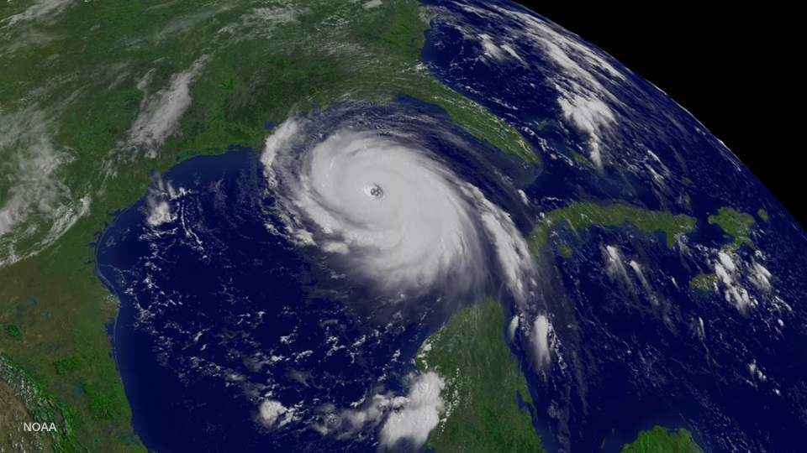
TEMPLATE
3. Hurricane Katrina, 2005
Notes:
More popular among Pre-M than WTC attack
Jerry Falwell got in on that action
Katrina was God’s wrath (think “Revelation”) being poured out on an evil city
https://www.metrowestdailynews.com/story/news/columns/2013/11/21/were-recent-illinois-tornadoes-sign/41826110007/
Pre-M always interpreting disasters as God’s wrath and judgment of Biblical and Revelation proportion.

Slide 39
3. Hurricane Katrina, 2005
“Jerry Falwell and Pat Robertson, for example, told us 12 years ago that the terrorist attacks of Sept. 11, 2001, were God’s punishment of America for a whole host of liberal misdeeds. And televangelist John Hagee told us eight years ago that Hurricane Katrina was God’s punishment of New Orleans for its gay-friendly ways.”
https://www.metrowestdailynews.com/story/news/columns/2013/11/21/were-recent-illinois-tornadoes-sign/41826110007/

Slide 40
3. Hurricane Katrina, 2005
“In a similar vein, Rev. John Hagee, . . . maintained that God caused Hurricane Katrina to wipe out New Orleans. In an interview, he blamed the hurricane on the city’s sinfulness. These two recent apocalyptic interpretations of Katrina fit into a long tradition of interpreting disasters as “Acts of God.””
https://jsri.loyno.edu/sites/loyno.edu.jsri/files/SJSJKatrinaarticle-1.pdf
Pre-M use natural disasters to pronounce God’s apocalyptic wrath and judgment of biblical and Revelation proportion.
Notes:
Pre-M always interpreting disasters as God’s apocalyptic wrath and judgment of Biblical and Revelation proportion.

Slide 41
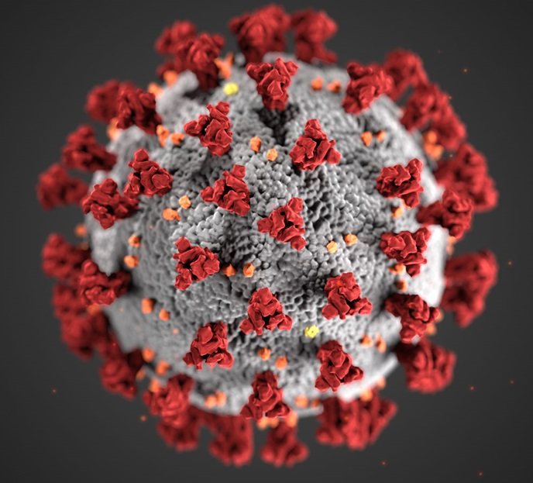
4. COVID - 19
Notes:
2 Pre-M claimed face-to-face with me that COVID-19 was predicted by Revelation
Of course, neither offered the chapter and verse
Next time a disaster occurs, tune into Trinity Broadcast network or any TV Pre-M preacher

Slide 42
4. COVID - 19
Covid-19 and the Apocalypse: Religious and Secular Perspectives
Historically pandemics have been attributed to both religious and naturalistic causes. While epidemics in the ancient world were generally accounted for in religious terms, a concept of contagion still existed (Feder 2013). Throughout history pandemics and apocalyptic narratives have run closely together. As one example explanations of the Black Death (1347–1352) involved ideas of sin and apocalypse, acts of God and alignments of the planets. While bad air, divine punishment and witchcraft were postulated causes, for many the Black Death signaled the end-times (Lerner 1981; Dwyer 2016). In another case, Howard (2008) reports on religious explanations of the 1918 Spanish flu epidemic where appeal was made to ideas of sin and
https://www.ncbi.nlm.nih.gov/pmc/articles/PMC7598223/
Notes:
National Center for Biotechnology Information
https://www.ncbi.nlm.nih.gov/pmc/articles/PMC7598223/

Slide 43
4. COVID - 19
Covid-19 and the Apocalypse: Religious and Secular Perspectives
(continued)
of an eschatological sign of Christ’s second coming. One member of the Dutch Reformed Church, Johanna Brandt, prophesied that the Day of Judgment had come. A pamphlet, The Millennium - A Prophetic Forecast, warned readers that the flu epidemic was only the beginning of the affliction that was stated in the Book of Revelations.
https://www.ncbi.nlm.nih.gov/pmc/articles/PMC7598223/
Notes:
National Center for Biotechnology Information
Eschatological: eh·skuh·tuh·laa·juh·kl
https://www.ncbi.nlm.nih.gov/pmc/articles/PMC7598223/

Slide 44
4. COVID - 19: References
https://www.ncbi.nlm.nih.gov/pmc/articles/PMC7598223/
Feder Y. Contagion and cognition: Bodily experience and the conceptualization of pollution (Ṭumʾah) in the Hebrew Bible. Journal of Near Eastern Studies.
Lerner R. The Black death and Western European eschatological mentalities. The American Historical Review. 1981;86(1):533–535. doi: 10.2307/1860369.
Dwyer, F. (2016).1348: A medieval apocalypse—the black death in Ireland. Finbar Dwyer.
Howard, P. (2008). Why did it happen?: Religious explanations of the "Spanish" flu epidemic in South Africa. Historically Speaking, 9(7), 34–36.
Notes:
References

Slide 45
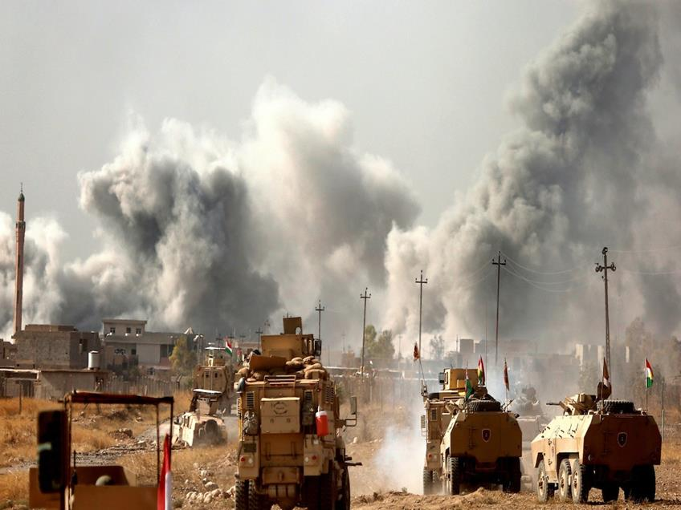
5. Wars and Rumors of Wars
Jack
Van Impe
Notes:
Jack Van Impe focuses in on a country invading another country (“wars & rumors of war”)
Pre-M need disasters to occur so that they can promote their doctrine.
Every generation has their own:
Mark of the Beast
Sign of the Apocalypse
Assignment of disasters to Revelation verses

Slide 46
“Disasters ‘R’ Us”
5 Disasters To Promote Agenda
Barringer Crater, Arizona
BP Oil Spill, 2010
Hurricane Katrina, 2005
Covid, 2019-2020
Wars and Rumors of War

Slide 47
Revelation 9:3
³ And there came out of the smoke locusts upon the earth: and unto them was given power, as the scorpions of the earth have power.
Why does John say “locusts” ?

Slide 48
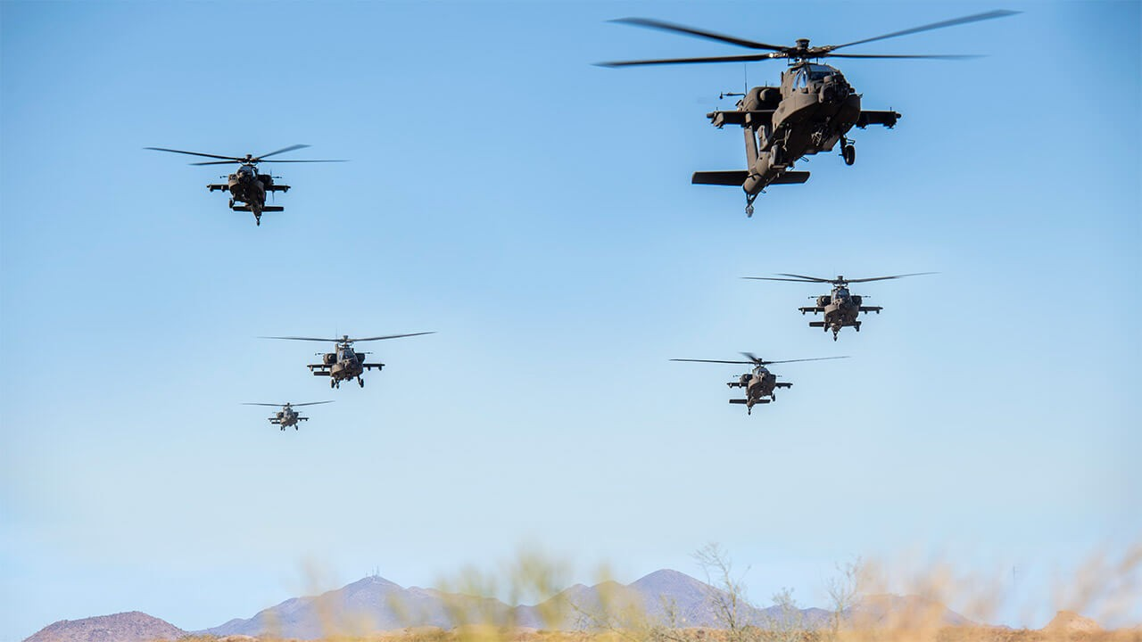
Apache helicopters: A vision of a future war

Slide 49
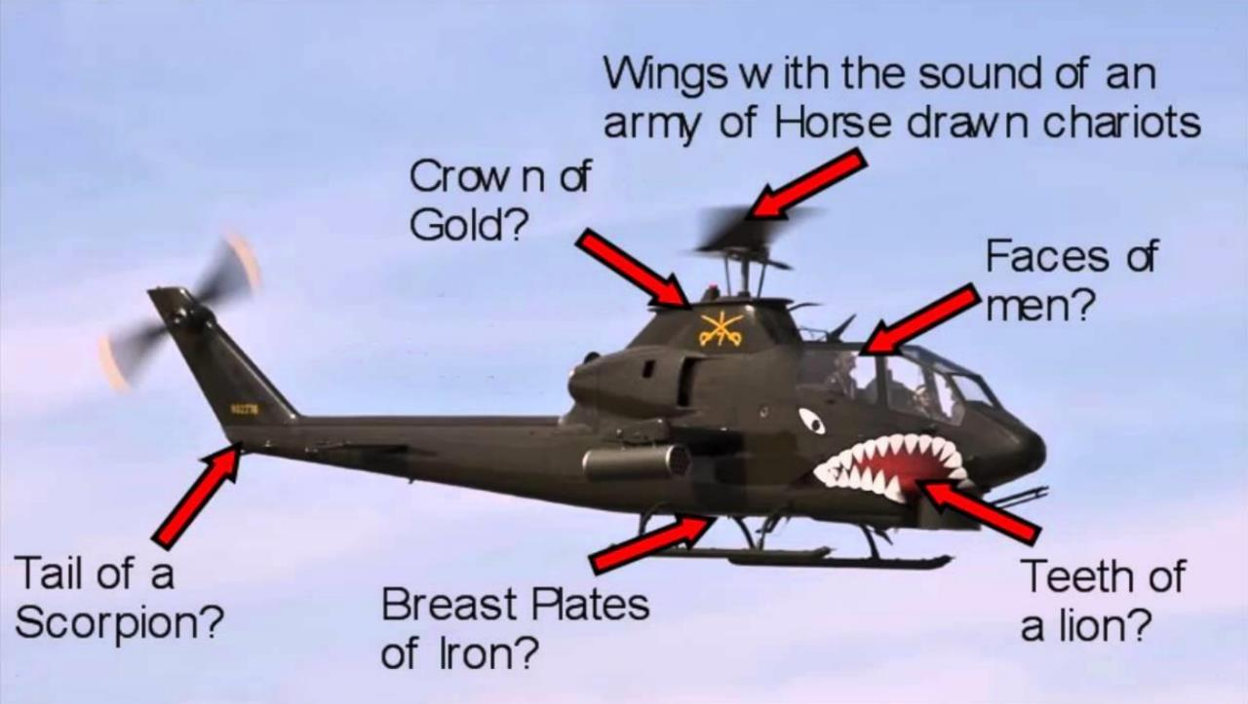
Notes:
Good description of a military helicopter.
Only way to counter that is to work within the entire context of Revelation.
Don’t pick one verse and force it into an interpretation and ignore the context of Revelation.
What did the 1st century Saints care about attack helicopters? Nothing!

Slide 50
Revelation 9:20-21
²⁰ And the rest of the men which were not killed by these plagues yet repented not of the works of their hands, that they should not worship devils [demons], and idols of gold, and silver, and brass, and stone, and of wood: which neither can see, nor hear, nor walk:
²¹ Neither repented they of their murders, nor of their sorceries, nor of their fornication, nor of their thefts.

Slide 51
Revelation 9:20-21
Worship demons and idols
Vesuvius - annual day Vulcan worshipped (god of iron,fire)
Murders
Miniature Roman colosseum in Pompeii
Sorceries
Magic, invoking evil spirits, very superstitious society, omens
Fornication (literal)
Very promiscuous
Thefts
Slaves – “theft of souls and bodies of men” (Rev. 18:13)
Notes:
“repented not”
God says 4x about the villain of Revelation plus 1 time in Rev 2 (gave Jezebel room to repent and she did not)
Video will prove through archaeology who was guilty of these 5 sins
Chapters 2-3: The word “repent” used 8x
4 times in rest of Revelation
Repentance is what God wants.
How/What does God do to bring about repentance? We don’t know.
Rev 8 - God “moved heaven and earth” to bring about repentance, but none occurred.
Rev 9 – Judgment is coming

